Slide 1
Offensive and Hateful Language Detection in Tweets using Neural Networks
Pardeep Kumar
Mentor: Dipanjan Sarkar

Slide 2
Objective
Detecting hateful and offensive language in twitter data using:
Decision Trees
Neural Networks
Classifier comparison based on performance metrics and computation speed

Slide 3
Problem Statement
Multiclass Classification Problem
Classifying tweets under one of the following classes:
Hate speech
Offensive speech
Neutral speech
Macro F1-Score as the performance metric for the classifiers

Slide 4
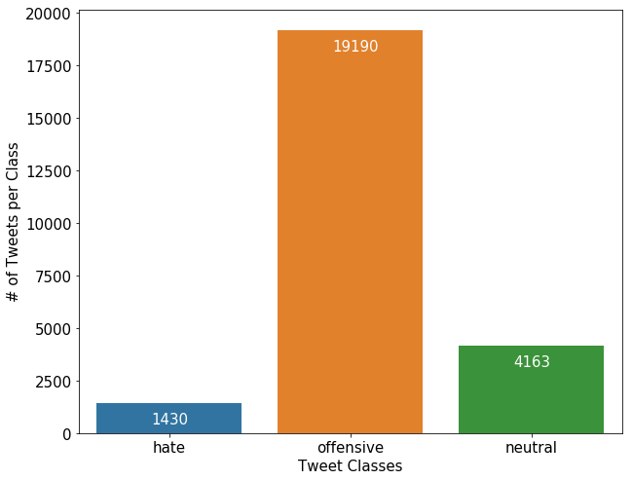
Data Mining
Collection of 24,784 tweets
Tweets classified under three categories
0 – Hate speech
1 – Offensive speech
2 – Neutral speech
Highly imbalanced Classes distribution:
77% offensive tweets
17% neutral tweets
6% hateful tweets

Slide 5
Text Preprocessing
Following features were removed from the tweet during preprocessing:
Username
Web address
Retweet Character (‘RT’)
Punctuations
Emoticons
Numeric data
Stop words: words like a, an and the.
All characters lowercase

Slide 6
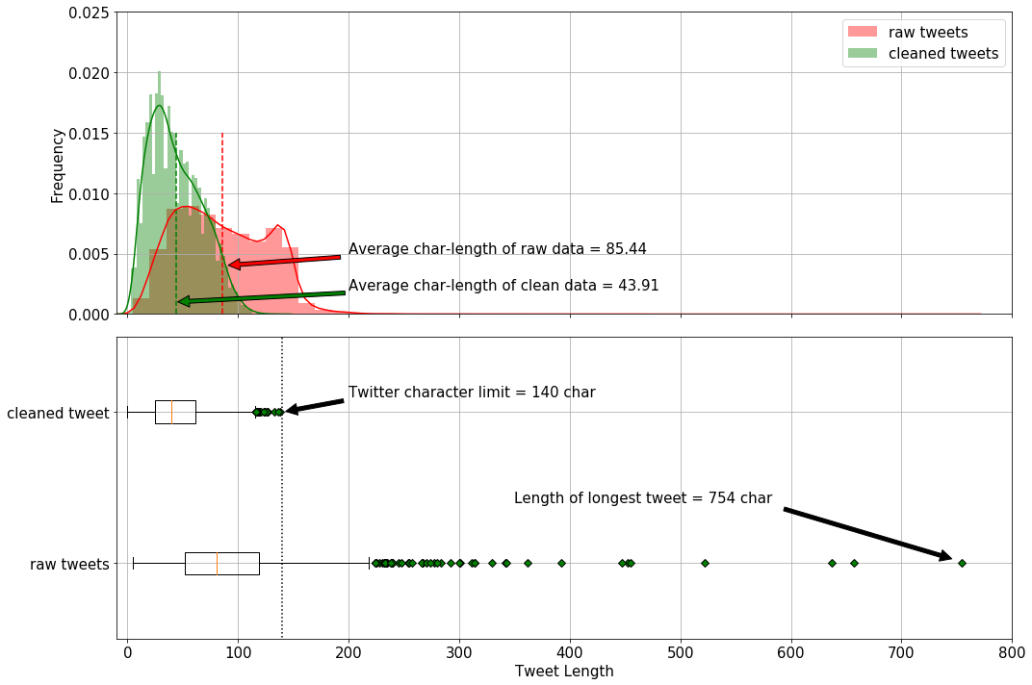
Processed Data Character Length

Slide 7
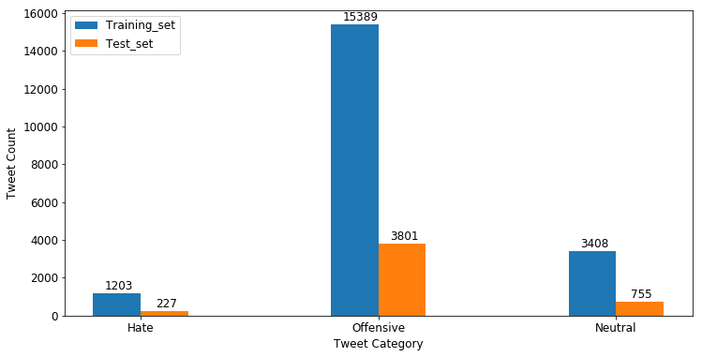
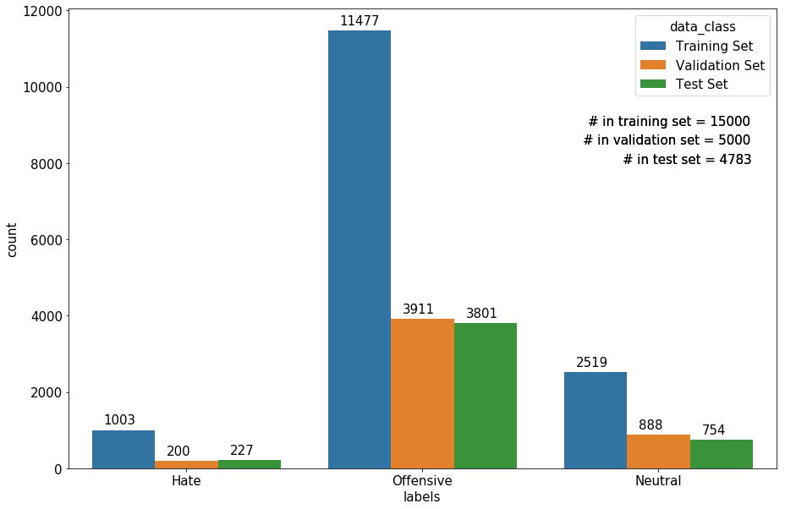
Training, Validation, Test Sets

Slide 8
Word-Vector Representation
Two primary techniques:
Bag-of-word model: Based on word count
Word embedding: Dense representation of bag-of-word vectors

Slide 9
Bag-of-Word Model

Slide 10
One-Hot Vectors

Slide 11
Co-Occurrence Matrix

Slide 12

TF-IDF Algorithm
The count of more frequently co-occurring words is crucial
Words that are more frequent lack of any useful information, e.g., stop words
Term Frequency – Inverse Document Frequency Algorithm (TF-IDF) algorithm can balance the two paradox to obtain an updated new-matrix.
Each entry in the updated matrix is the product of the term-frequency and the inverse document frequency
$$C_{t,d}^{updated}={tf}_{t,d}×{idf}_{t,d}$$

Slide 13

TF-IDF Algorithm
Term frequency
words that occur more frequently receive a higher penalty
$${tf}_{t,d}=\left\{\begin{matrix}1+\log_{10}{C_{t,d}}, if C_{t,d}>0 \\ 0 otherwise\end{matrix}\right.$$
Inverse document frequency ($idf$)
assigns relative importance to more discriminative words, words that might appear more often in one document but sparsely in the rest of the text-corpus.
$${idf}_{t,d}=\log_{10}\left(\frac{size of text corpus}{ number of documents the term t occurs }\right)$$

Slide 14
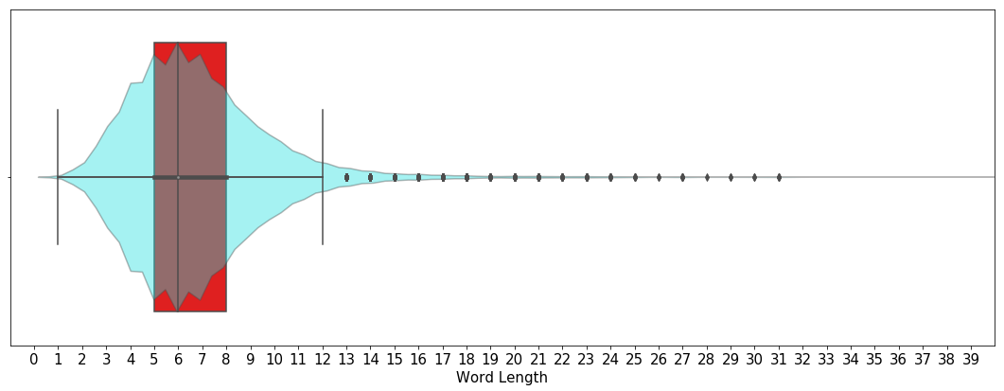

Feature Selection
Average word length = 6
Median word length = 6
Most common word length = 6
8 different N-gram features :
Character level $N$-grams where $N∈\left\{2, 3, 4, 5, 6\right\}$
Word level $N$-grams where $N∈\left\{1, 2, 3\right\}$

Slide 15
Word Embeddings

Slide 16
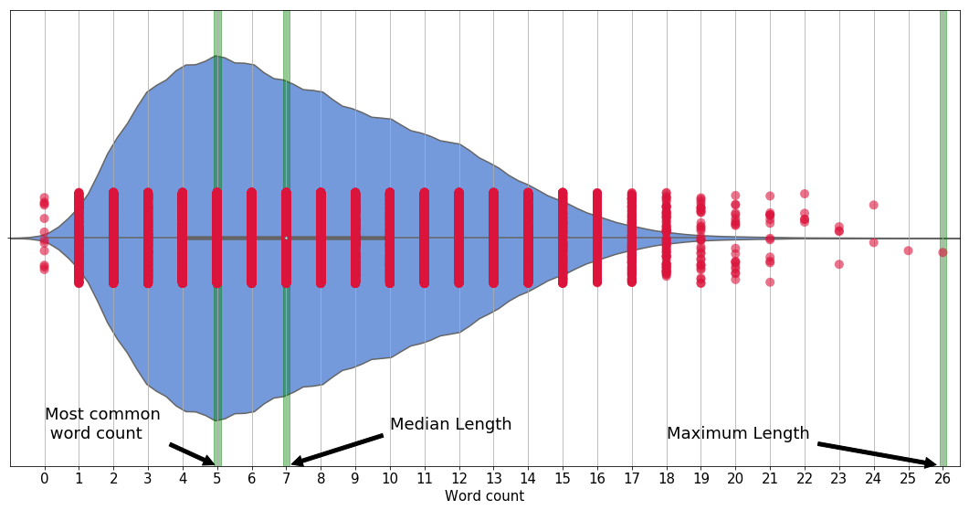
Tokenization
Maximum word count = 26
Total Vocabulary Size = 18,498
Each tweet was zero-padded to make each input of size 26
Word embedding using GloVe model with 400,000 words
Each word transformed into 300-dimensional vector

Slide 17
Word Embedding
Each tweet was split into tokens (words)
Index each unique word to form data vocabulary
Query each data vocabulary word against GloVe dataset
Extract the vectors of the data vocabulary

Slide 18
Decision Trees
Majority Class Baseline
Random Forests

Slide 19
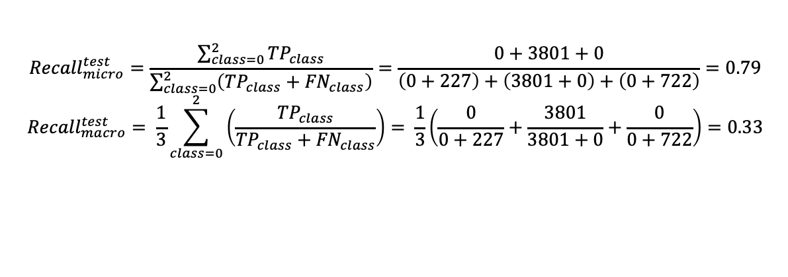
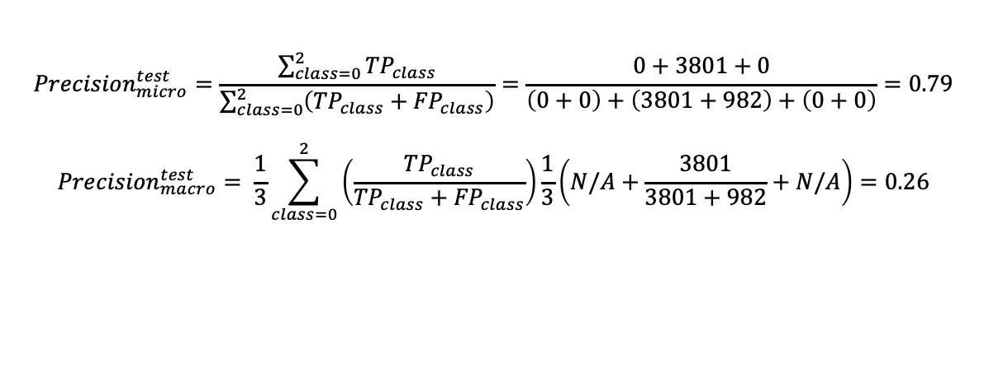
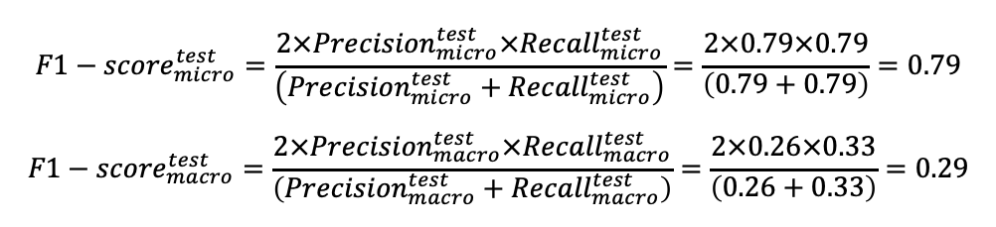
Majority Class Base Model Precision Recall F1- Score
$${Precision}_{micro}^{test}=\frac{\sum_{class=0}^{2}{{TP}_{class}}}{\sum_{class=0}^{2}{\left({TP}_{class}+{FP}_{class}\right)}}=\frac{0+3801+0}{\left(0+0\right)+\left(3801+982\right)+\left(0+0\right)}=0.79$$
$${Precision}_{macro}^{test}= \frac{1}{3}\sum_{class=0}^{2}{\left(\frac{{TP}_{class}}{{TP}_{class}+{FP}_{class}}\right)}\frac{1}{3}\left(N/A+\frac{3801}{3801+982}+N/A\right)=0.26$$
$${Recall}_{micro}^{test}=\frac{\sum_{class=0}^{2}{{TP}_{class}}}{\sum_{class=0}^{2}{\left({TP}_{class}+{FN}_{class}\right)}}=\frac{0+3801+0}{\left(0+227\right)+\left(3801+0\right)+\left(0+722\right)}=0.79$$
$${Recall}_{macro}^{test}= \frac{1}{3}\sum_{class=0}^{2}{\left(\frac{{TP}_{class}}{{TP}_{class}+{FN}_{class}}\right)}= \frac{1}{3}\left(\frac{0}{0+227}+\frac{3801}{3801+0}+\frac{0}{0+722}\right)=0.33$$
$${F1−score}_{micro}^{test}=\frac{2×{Precision}_{micro}^{test}×{Recall}_{micro}^{test}}{\left({Precision}_{micro}^{test}+{Recall}_{micro}^{test}\right)}=\frac{2×0.79×0.79}{\left(0.79+0.79\right)}=0.79$$
$${F1−score}_{macro}^{test}=\frac{2×{Precision}_{macro}^{test}×{Recall}_{macro}^{test}}{\left({Precision}_{macro}^{test}+{Recall}_{macro}^{test}\right)}=\frac{2×0.26×0.33}{\left(0.26+0.33\right)}=0.29$$

Slide 20
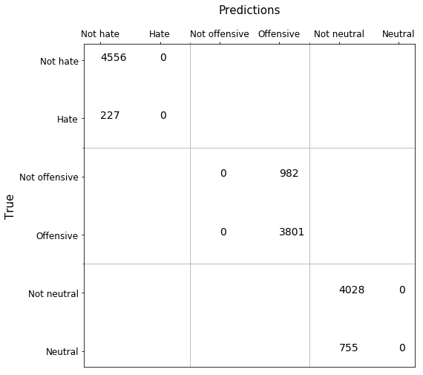
Majority Class Base Model Confusion Matrix

Slide 21
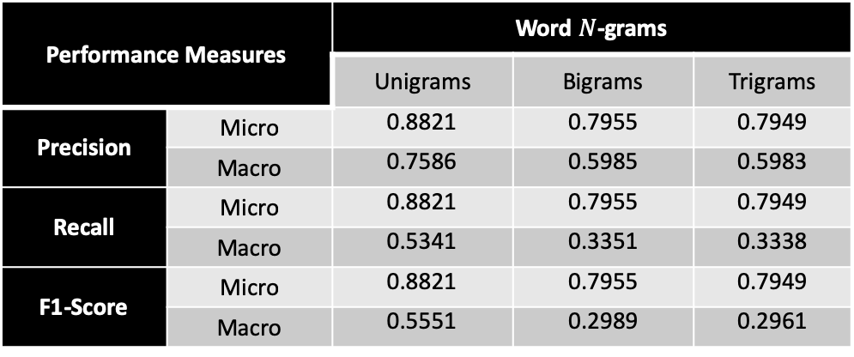
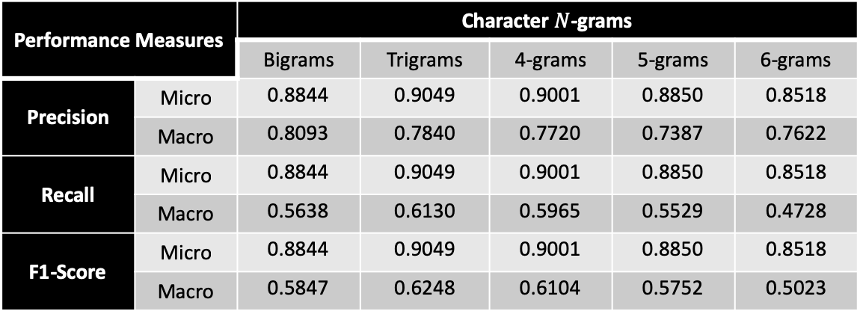
Random Forests Performance
Performance Measures |  | Character $N$-grams
 |  | Bigrams | Trigrams | 4-grams | 5-grams | 6-grams
Precision | Micro | 0.8844 | 0.9049 | 0.9001 | 0.8850 | 0.8518
 | Macro | 0.8093 | 0.7840 | 0.7720 | 0.7387 | 0.7622
Recall | Micro | 0.8844 | 0.9049 | 0.9001 | 0.8850 | 0.8518
 | Macro | 0.5638 | 0.6130 | 0.5965 | 0.5529 | 0.4728
F1-Score | Micro | 0.8844 | 0.9049 | 0.9001 | 0.8850 | 0.8518
 | Macro | 0.5847 | 0.6248 | 0.6104 | 0.5752 | 0.5023
Performance Measures |  | Word $N$-grams
 |  | Unigrams | Bigrams | Trigrams
Precision | Micro | 0.8821 | 0.7955 | 0.7949
 | Macro | 0.7586 | 0.5985 | 0.5983
Recall | Micro | 0.8821 | 0.7955 | 0.7949
 | Macro | 0.5341 | 0.3351 | 0.3338
F1-Score | Micro | 0.8821 | 0.7955 | 0.7949
 | Macro | 0.5551 | 0.2989 | 0.2961

Slide 22
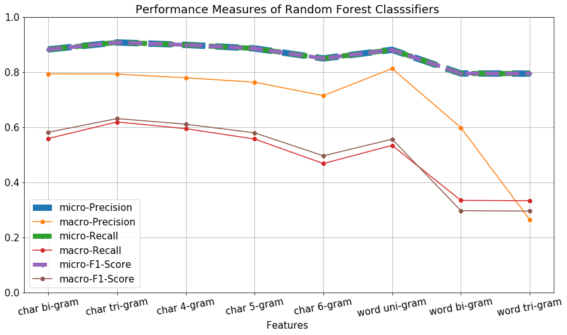
Random Forests Performance Comparison

Slide 23
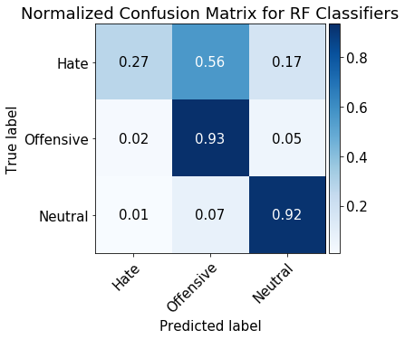
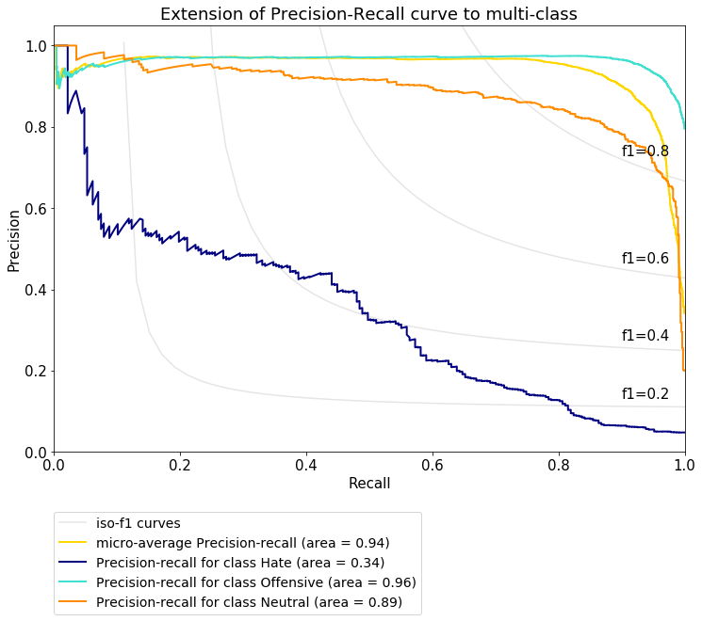
Random Forests Metrics

Slide 24
Neural Networks
Multilayer Perceptions (MLP)
1D Convolution Neural Networks (1D Covnets)
Long-Short Term Memory Networks (LSTM)

Slide 25
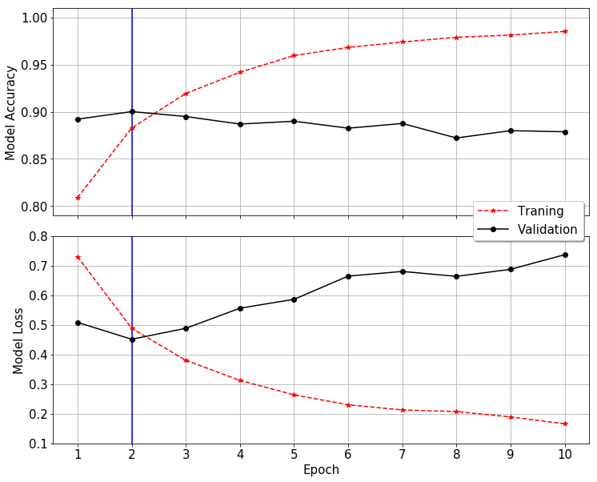
MLP Model Fit
Min. validation loss = 45% → validation accuracy = 90%

Slide 26
MLP Architecture & Performance
 | PR_AUC | F1-SCORE | PRECISION | RECALL
Hate | 0.2892 | 0.3416 | 0.3898 | 0.3040
Offensive | 0.9735 | 0.9357 | 0.9247 | 0.9469
Neutral | 0.8618 | 0.7828 | 0.8053 | 0.7616
Micro Avg | 0.9461 | 0.8871 | 0.8871 | 0.8871
Macro Avg | 0.7082 | 0.6867 | 0.7066 | 0.6708
Weighted Avg | 0.9234 | 0.8833 | 0.8805 | 0.8871
Samples Avg | 0.9395 | 0.8871 | 0.8871 | 0.8871

Slide 27
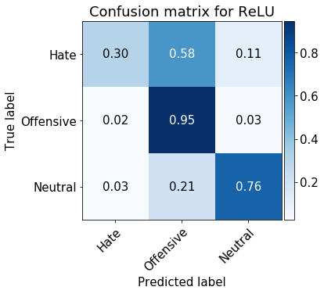
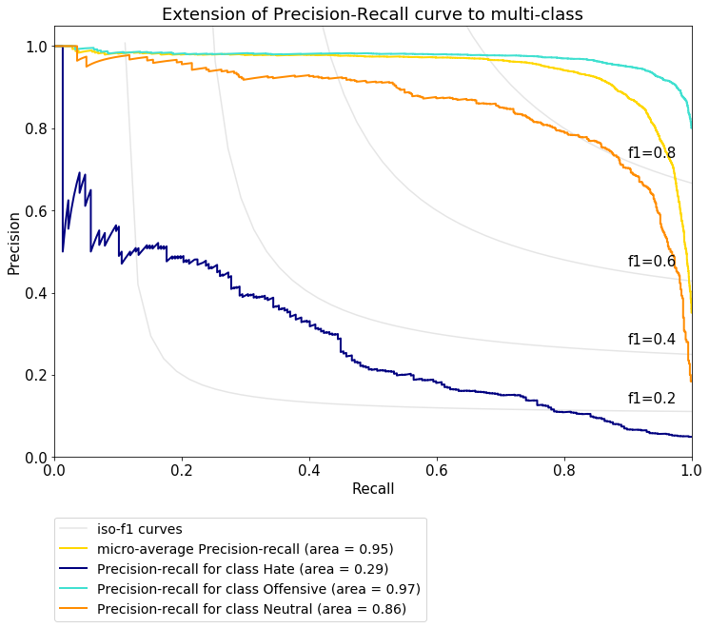
MLP Performance Metrics

Slide 28
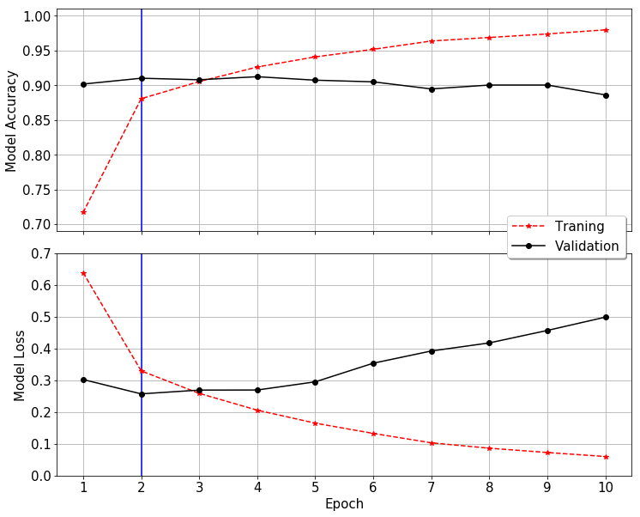
1D COVNETS MODEL FIT
Min. validation loss = 26% → validation accuracy = 91%

Slide 29
1D COVNETS Architecture

Slide 30
1D COVNETS Performance
 | PR_AUC | F1-SCORE | PRECISION | RECALL
Hate | 0.3362 | 0.3900 | 0.5303 | 0.3084
Offensive | 0.9820 | 0.9476 | 0.9338 | 0.9619
Neutral | 0.8943 | 0.8357 | 0.8465 | 0.8252
Micro Avg | 0.9610 | 0.9093 | 0.9093 | 0.9093
Macro Avg | 0.7375 | 0.7244 | 0.7702 | 0.6985
Weighted Avg | 0.9375 | 0.9035 | 0.9009 | 0.9093
Samples Avg | 0.9521 | 0.9093 | 0.9093 | 0.909

Slide 31
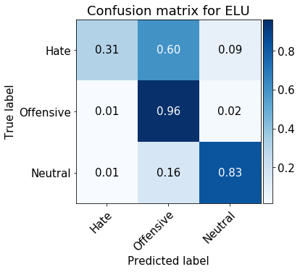
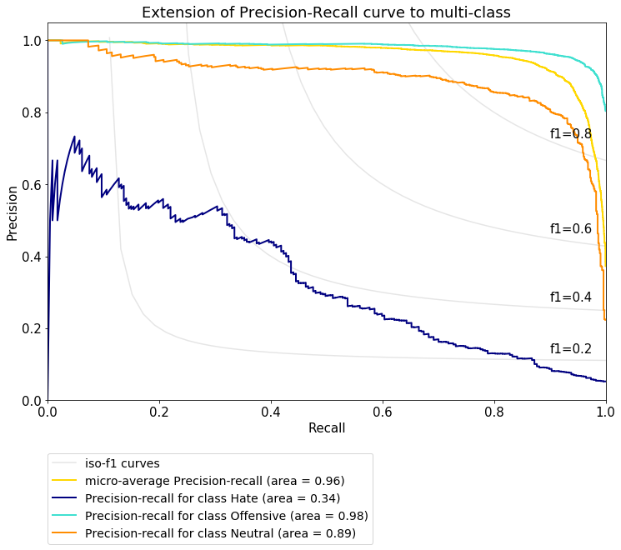
1D COVNETS Performance Metrics

Slide 32
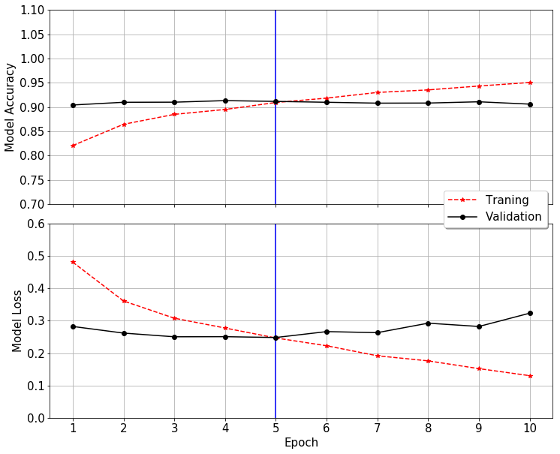
LSTM Model Fit
Min. validation loss = 25% → validation accuracy = 91%

Slide 33
LSTM Architecture & Performance
 | PR_AUC | F1-SCORE | PRECISION | RECALL
Hate | 0.382469 | 0.404878 | 0.453552 | 0.365639
Offensive | 0.983171 | 0.949375 | 0.949001 | 0.949750
Neutral | 0.915308 | 0.865248 | 0.842965 | 0.888742
Micro Avg | 0.963747 | 0.912398 | 0.912398 | 0.912398
Macro Avg | 0.760316 | 0.739834 | 0.748506 | 0.734710
Weighted Avg | 0.943949 | 0.910254 | 0.908749 | 0.912398
Samples Avg | 0.953760 | 0.912398 | 0.912398 | 0.912398

Slide 34
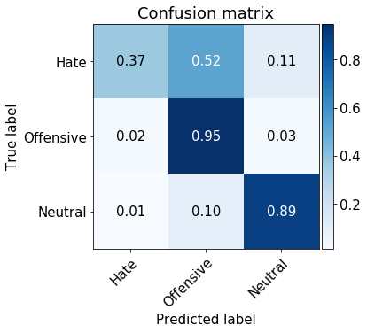
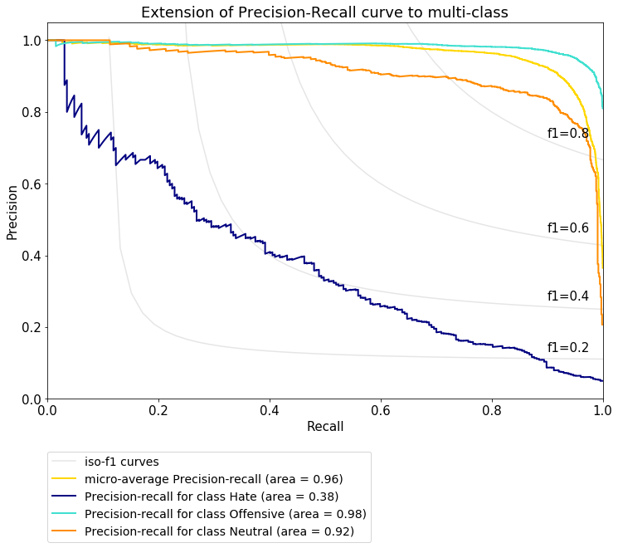
LSTM Performance Metrics

Slide 35
SUMMARY Performance Comparison

Slide 36
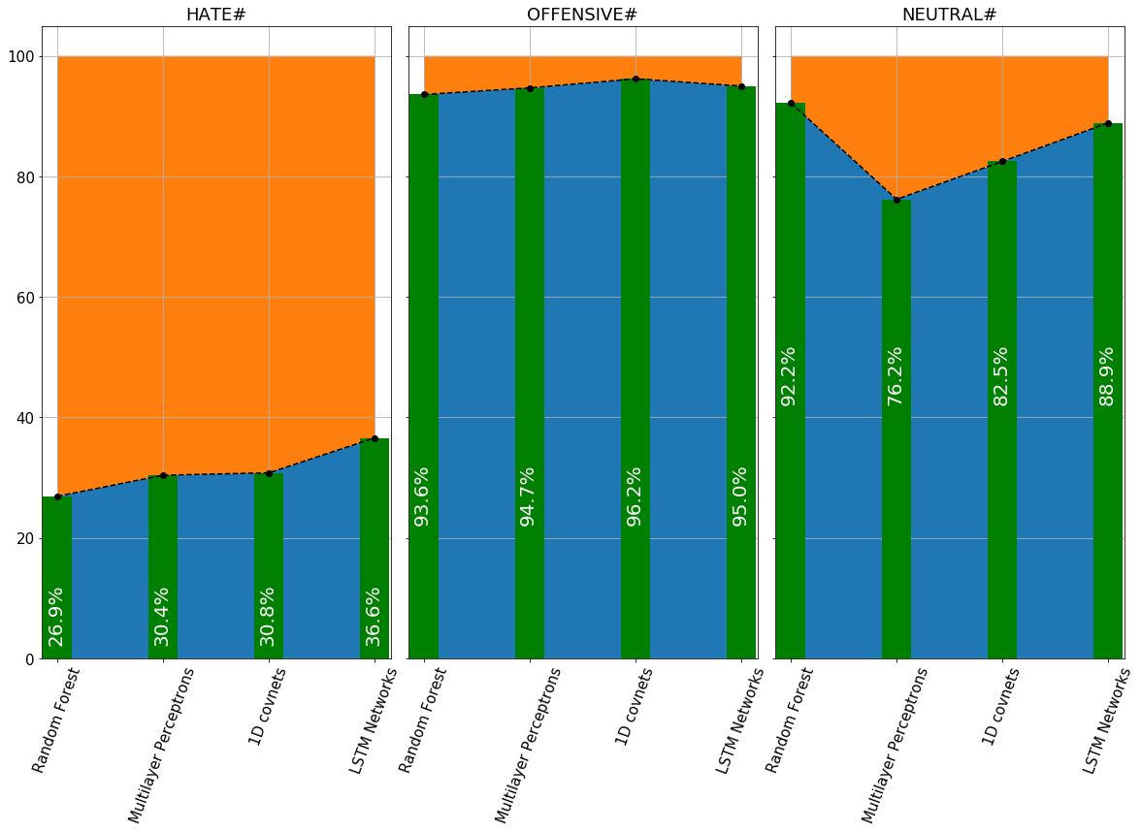
SUMMARY Performance Comparison

Slide 37
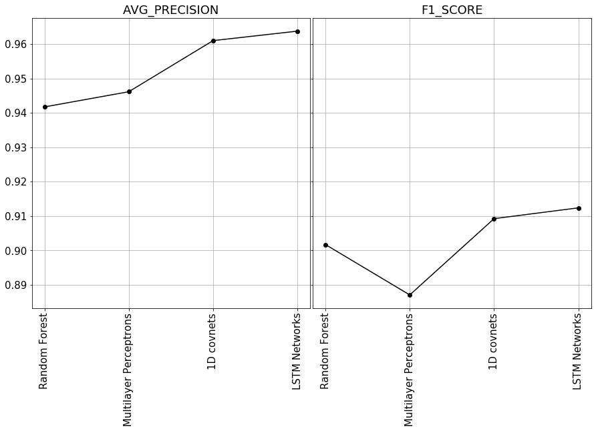
SUMMARY Performance Comparison

Slide 38
SUMMARY
Due to data class imbalance, micro-average F1-score, micro-average precision score (area under precision-recall curve) and confusion matrix were compared simultaneously to compare different classifiers
Priority given to the confusion matrix as focus of the study was to develop classifiers that can filter negative speech.
LSTM outperformed other models in terms of micro-average precision and f1-score
LSTM was also able to have higher count of true positives for hate class about 36%, 21% and 19% more than the random forest, MLP and 1D covnets, respectively
Overall the neural network models performed relatively better than the random forest model suggesting their ability to classify imbalanced class data better than random forests.

Slide 39
Thank you

